Slide 1
HIRING PROCESS PROJECT
Press The Link GO TO JOBDATA SHEET TO CHECK

Slide 2
APPROACH:
Download The dataset.
Approach the solution by performing Ms Excel Formulas.
Analyse the solution.
Note them down.
EXCEL LINK: Press The Link

Slide 3

Press The Link GO TO JOBDATA SHEET TO CHECK

Slide 4
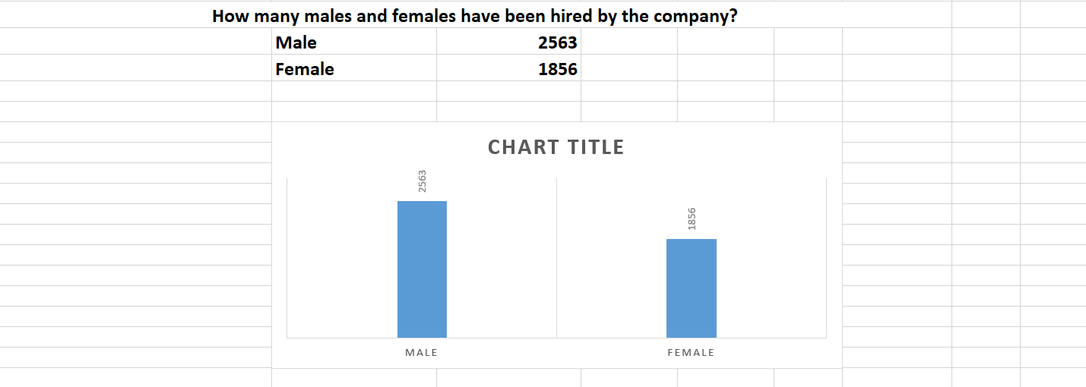

Slide 5
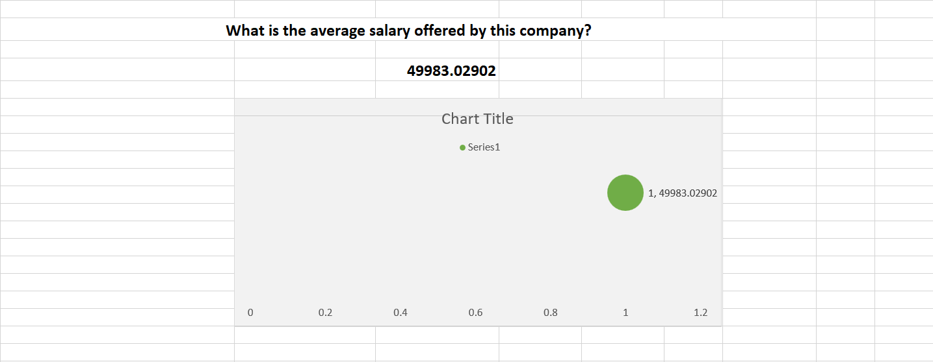

Slide 6
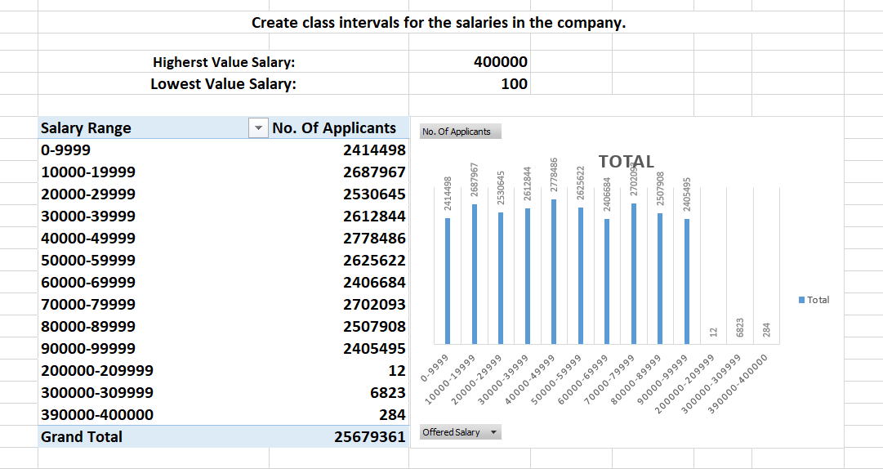

Slide 7
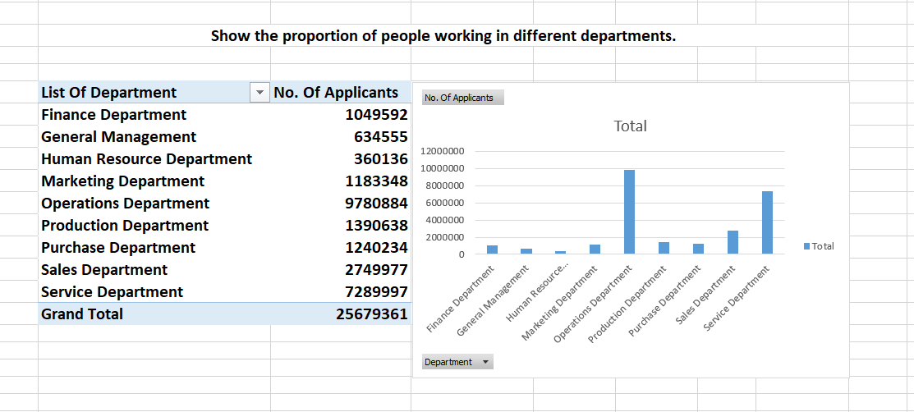

Slide 8
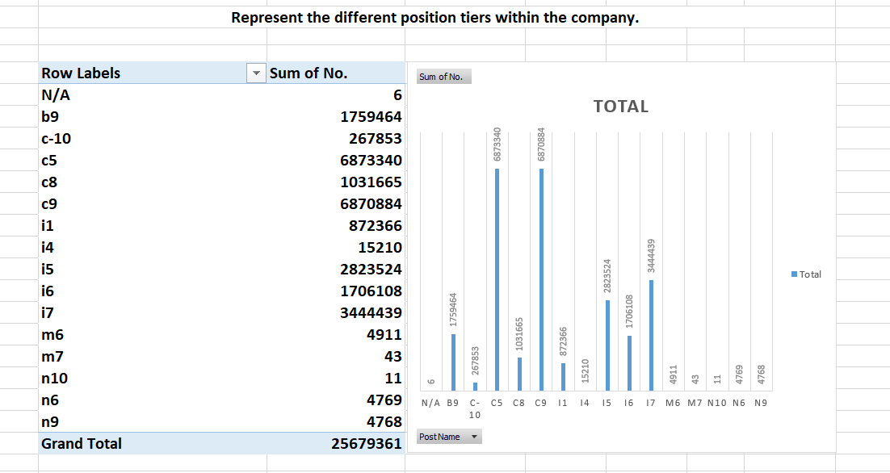

Slide 9
THANK U

